Slide 1

Spring Boot For Beginners
#codefarm
Comprehensive Guide With Real Time Project Implementation

Slide 2
#1 Introduction to Spring Boot
#codefarm
Comprehensive Guide With Real Time Project Implementation

Slide 3
Introduction to Spring Framework
#codefarm
History
Created by Rod Johnson and released in 2003, as a response to the complexity of early J2EE specifications.
Spring aims to simplify Java development by providing comprehensive infrastructure support for developing Java applications.
Over time, the role of Java/Jakarta EE in application development has evolved.
Spring continues to innovate and to evolve.
Beyond the Spring Framework, there are other projects, such as Spring Boot, Spring Security, Spring Data, Spring Cloud, Spring Batch, among others

Slide 4
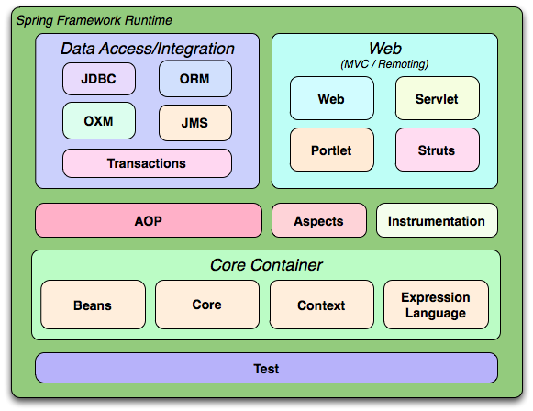
Introduction to Spring Framework
#codefarm
Overview of features
Core Container: Manages the lifecycle and configuration of application objects.
Spring AOP: Supports aspect-oriented programming, allowing separation of cross-cutting concerns like logging, transaction management, etc.
Data Access/Integration: Simplifies database interaction with JDBC and ORM modules.
Web Module: Provides integration with popular web frameworks.
Test Module: Supports unit testing and integration testing.

Slide 5
Introduction to Spring Framework
#codefarm
Advantages of Spring
Lightweight
Inversion of Control (IoC)
Aspect-Oriented Programming (AOP)
Comprehensive Infrastructure Support
Testing: Easier testing with dependency injection and mock objects.

Slide 6
What is Spring Boot?
#codefarm
Spring Boot makes it easy to create stand-alone, production-grade Spring based Applications that you can "just run".
It takes an opinionated view of the Spring platform and third-party libraries so you can get started with minimum fuss. Most Spring Boot applications need minimal Spring configuration.

Slide 7
Features of Spring Boot
#codefarm
Create stand-alone Spring applications
Embed Tomcat, Jetty or Undertow directly (no need to deploy WAR files)
Provide opinionated 'starter' dependencies to simplify your build configuration
Automatically configure Spring and 3rd party libraries whenever possible
Provide production-ready features such as metrics, health checks, and externalized configuration
Absolutely no code generation and no requirement for XML configuration

Slide 8
Spring Boot vs Traditional Spring
#codefarm
Feature | Traditional Spring | Spring Boot
Configuration | Requires extensive XML or Java-based configuration. | Minimal configuration with auto-configuration support.
Embedded Servers | Requires an external server like Tomcat or Jetty. | Comes with embedded servers like Tomcat, Jetty, Undertow.
Startup Time | Slower due to extensive configuration and setup. | Faster startup due to auto-configuration and embedded server.
Production-Ready | Requires additional setup for monitoring and metrics. | Built-in support for metrics, health checks, etc.
Project Initialization | Manual setup of dependencies and configurations. | Spring Initializr for quick project bootstrapping.
Microservices Support | Requires manual configuration for microservices setup. | Simplifies microservices development with built-in support.
Ease of Use | Steeper learning curve with more manual setup. | Easier to use with opinionated defaults and starters.

Slide 9
#2 Setting Up the Development Environment
#codefarm
Comprehensive Guide With Real Time Project Implementation

Slide 10
Topics to Cover
#codefarm
Installing Java Development Kit (JDK)
Setting up IntelliJ IDE
Introduction to Maven/Gradle
Writing Your First Spring Boot Application

Slide 11
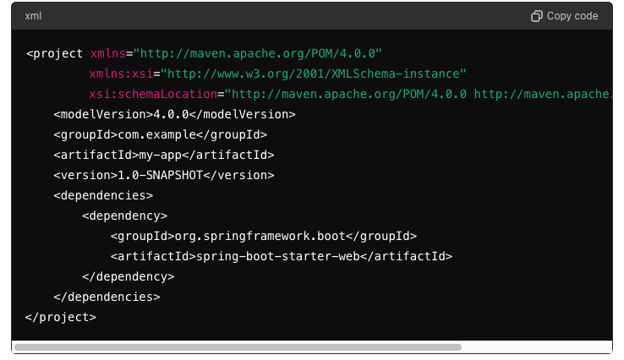
Maven
#codefarm
What is Maven?
Maven is a build automation and project management tool primarily used for Java projects. It uses an XML file (pom.xml) to manage a project's build, dependencies, and documentation.
Key Features
Dependency Management: Automatically downloads project dependencies and manages version conflicts.
Build Lifecycle: Defines a standard lifecycle for building, testing, and packaging projects.
Project Structure: Enforces a standard project structure.
Plugins: Extensible via plugins for additional functionality (e.g., compiling code, running tests).

Slide 12
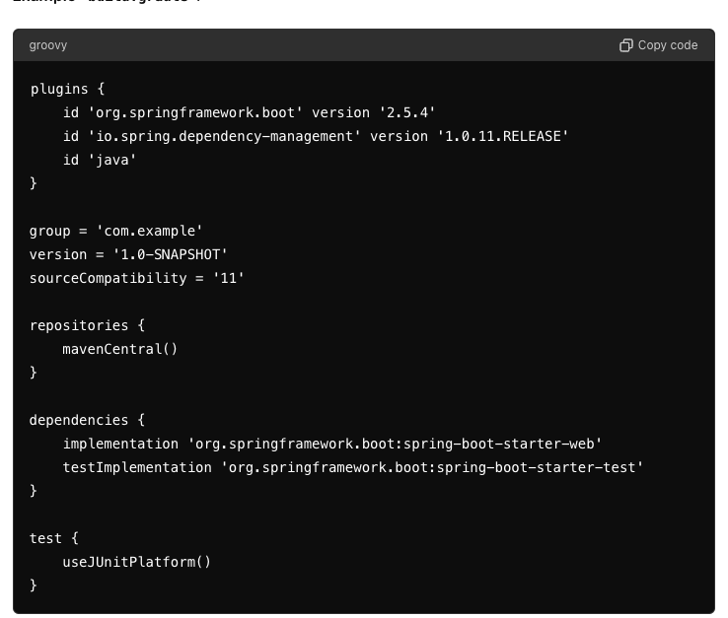
Gradle
#codefarm
What is Gradle?
Gradle is a flexible build automation tool that uses a Groovy-based DSL (domain-specific language) or Kotlin for configuration. It is designed to be more expressive and powerful compared to traditional build tools like Maven.
Key Features
Declarative Builds: Uses a DSL to declare project settings and dependencies.
Incremental Builds: Only builds the parts of the project that have changed, improving build times.
Task-Based Model: Allows custom tasks to be defined and executed as part of the build process.
Dependency Management: Similar to Maven but with more flexibility.

Slide 13
Maven vs Gradle
#codefarm
Feature | Maven | Gradle
Configuration | XML-based (pom.xml) | Groovy/Kotlin-based (build.gradle)
Performance | Slower due to non-incremental builds | Faster with incremental builds
Ease of Use | Steeper learning curve due to XML complexity | More intuitive with Groovy/Kotlin DSL
Flexibility | Convention over configuration | Highly customizable and flexible
Dependency Management | Strong dependency management capabilities | More flexible dependency management
Plugins | Extensive plugin ecosystem | Growing plugin ecosystem
Community Support | Large, established community | Rapidly growing community

Slide 14
#3 Spring Boot Basics
#codefarm
Comprehensive Guide With Real Time Project Implementation

Slide 15
Topics to Cover
#codefarm
Understanding the Project (Problem Statement)
Understanding the Project Structure (Technical)
Spring Boot Starters
@SpringBootApplication Annotation

Slide 16
#4 Building RESTful Web Services
#codefarm
Comprehensive Guide With Real Time Project Implementation

Slide 17
Topics to Cover
#codefarm
Introduction to RESTful Services
Building a Simple RESTful Service
@RestController and @RequestMapping
Handling HTTP Methods (GET, POST, PUT, DELETE)
Path Variables and Request Parameters

Slide 18
#5 Spring Boot Data Access
#codefarm
Comprehensive Guide With Real Time Project Implementation

Slide 19
Topics to Cover
#codefarm
Introduction to Spring Data JPA
Configuring Data Source
H2 DB for development
MySQL for production use cases
Creating Repository Interfaces
CRUD Operations with JPA Repositories

Slide 20
#6 Exception Handling
#codefarm
Comprehensive Guide With Real Time Project Implementation

Slide 21
Topics to Cover
#codefarm
Handling Exceptions in Spring Boot
@ControllerAdvice and @ExceptionHandler
Custom Exception Handling

Slide 22
#7 Testing in Spring Boot
#codefarm
Comprehensive Guide With Real Time Project Implementation

Slide 23
Topics to Cover
#codefarm
Introduction to Unit Testing
Writing Unit Tests with JUnit and Mockito
Integration Testing with Spring Boot
Testing RESTful Services

Slide 24
#8 Security in Spring Boot
#codefarm
Comprehensive Guide With Real Time Project Implementation

Slide 25
Topics to Cover
#codefarm
Introduction to Spring Security
Implementing Basic Authentication
JWT Authentication
Role-Based Access Control

Slide 26
#9 Advanced Topics in Spring Boot
#codefarm
Comprehensive Guide With Real Time Project Implementation

Slide 27
Topics to Cover
#codefarm
Introduction to Microservices with Spring Boot
Service Registration and Discovery with Eureka
Circuit Breaker with Resilience4J
API Gateway with Spring Cloud Gateway
Centralize Config Server
Distributed Tracing with Micrometer & Zipkin

Slide 28
#10 Deployment, Monitoring & Logging
#codefarm
Comprehensive Guide With Real Time Project Implementation

Slide 29
Topics to Cover
#codefarm
Where to deploy the service?
Monitoring the service
Logging

